Slide 1
Local-Area Network (LAN)
  Speeds up to 40 Gbps for fastest Ethernet over twisted pair copper or optical fiber.
  Wireless spectrum (Wi-Fi) increasingly used for networking
    I.e., IEEE 802.11g standard implemented at 54 Mbps

Slide 2
Communication Structure
The design of a communication network must address four basic issues:
Naming and name resolution - How do two processes locate each other to communicate?
Routing strategies - How are messages sent through the network?
Connection strategies - How do two processes send a sequence of messages?
Contention - The network is a shared resource, so how do we resolve conflicting demands for its use?

Slide 3
Naming and Name Resolution
Name systems in the network
Address messages with the process-id
Identify processes on remote systems by <host-name, identifier> pair.
  host name is a name unique within the network
  identifier is a process identifier or other unique number within that host.
  A host name is usually an alphanumeric identifier, rather than a number, to make it easier for users to specify.
Names are convenient for humans to use, but computers prefer numbers for speed and simplicity.
  Need a mechanism to resolve host name into host-id that describes the destination system to networking hardware.
Domain name system (DNS) – specifies the naming structure of the hosts, as well as name to address resolution (Internet)
  Hosts on Internet logically addressed with multipart names known as IP addresses.
  Parts of IP address progress from most specific to most general.

Slide 4
Routing Strategies
Fixed routing - A path from A to B is specified in advance; path changes only if a hardware failure disables it
  Since the shortest path is usually chosen, communication costs are minimized
  Fixed routing cannot adapt to load changes
  Ensures that messages will be delivered in the order in which they were sent
Virtual routing- A path from A to B is fixed for the duration of one session. Different sessions involving messages from A to B may have different paths
  Partial remedy to adapting to load changes
  Ensures that messages will be delivered in the order in which they were sent

Slide 5
Routing Strategies (Cont.)
Dynamic routing - The path used to send a message form site A to site B is chosen only when a message is sent
  Usually a site sends a message to another site on the link least used at that particular time
  Adapts to load changes by avoiding routing messages on heavily used path
  Messages may arrive out of order
    This problem can be remedied by appending a sequence number to each message
  Most complex to set up
Tradeoffs mean all methods are used
  UNIX provides ability to mix fixed and dynamic
  Hosts may have fixed routes and gateways connecting networks together may have dynamic routes

Slide 6
Routing Strategies (Cont.)
Router is communications processor responsible for routing messages
Must have at least 2 network connections
Maybe special purpose or just function running on host
Checks its tables to determine where destination host is, where to send messages
  Static routing – table only changed manually
  Dynamic routing – table changed automatically via routing protocol
More recently, routing managed by intelligent software more intelligently than routing protocols
  OpenFlow is device-independent, allowing developers to introduce network efficiencies by decoupling data-routing decisions from underlying network devices

Slide 7
Packet Strategies
Messages vary in length – simplified design breaks them into packets (or frames, or datagrams)
A communication implemented in one packet can be sent to its destination in a connectionless message.
  can be unreliable, in which case sender has no guarantee that, and cannot tell whether, the packet reached its destination.
Alternatively, the packet can be reliable
  an acknowledgement packet is returned from the destination indicating that the original packet arrived.
  If message too long to fit within one packet, or if packets need to flow back and forth between two communicators, a connection is established to allow reliable exchange of multiple packets.

Slide 8
Connection Strategies
Once messages reach destinations, processes can institute communications sessions to exchange information.
Pairs of processes that want to communicate over the network can be connected in a number of ways. Three most common schemes are:
Circuit switching - A permanent physical link is established for the duration of the communication (i.e., telephone system)
Message switching - A temporary link is established for the duration of one message transfer (i.e., post-office mailing system)
Packet switching - Messages of variable length are divided into fixed-length packets which are sent to the destination
  Each packet may take a different path through the network
  The packets must be reassembled into messages as they arrive
Circuit switching requires setup time, but incurs less overhead for shipping each message, and may waste network bandwidth
Message and packet switching require less setup time, but incur more overhead per message.
Packet switching most commonly used on data networks because it makes the best use of network bandwidth.

Slide 9
Communication Protocol
The communication network is partitioned into the following multiple layers:
Layer 1: Physical layer – handles the mechanical and electrical details of the physical transmission of a bit stream
Layer 2: Data-link layer – handles the frames, or fixed-length parts of packets, including any error detection and recovery that occurred in the physical layer
Layer 3: Network layer – provides connections and routes packets in the communication network, including handling the address of outgoing packets, decoding the address of incoming packets, and maintaining routing information for proper response to changing load levels

Slide 10
Communication Protocol (Cont.)
Layer 4: Transport layer – responsible for low-level network access and for message transfer between clients, including partitioning messages into packets, maintaining packet order, controlling flow, and generating physical addresses
Layer 5: Session layer – implements sessions, or process-to-process communications protocols
Layer 6: Presentation layer – resolves the differences in formats among the various sites in the network, including character conversions, and half duplex/full duplex (echoing)
Layer 7: Application layer – interacts directly with the users, deals with file transfer, remote-login protocols and electronic mail, as well as schemas for distributed databases

Slide 11
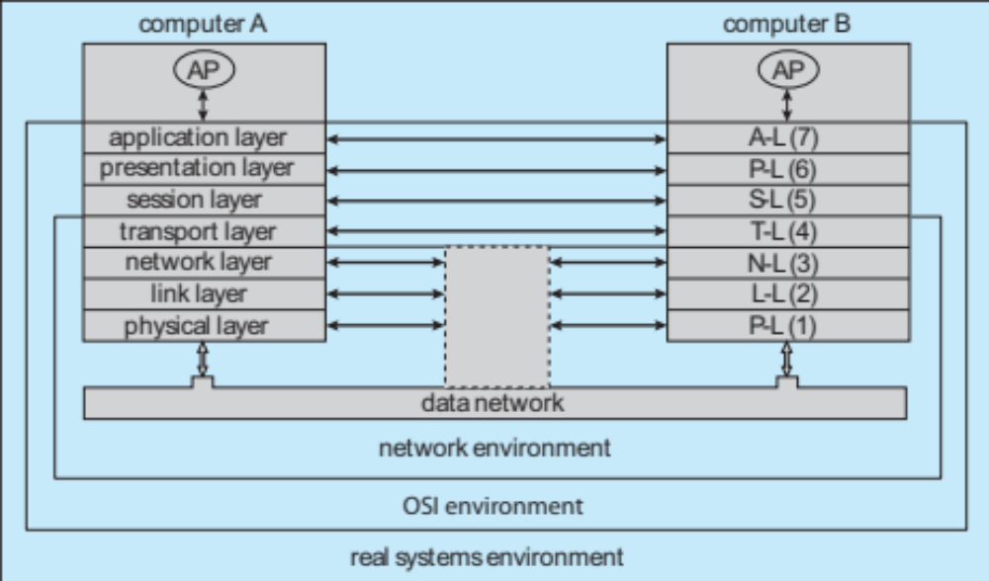
Communication Via ISO Network Model

Slide 12
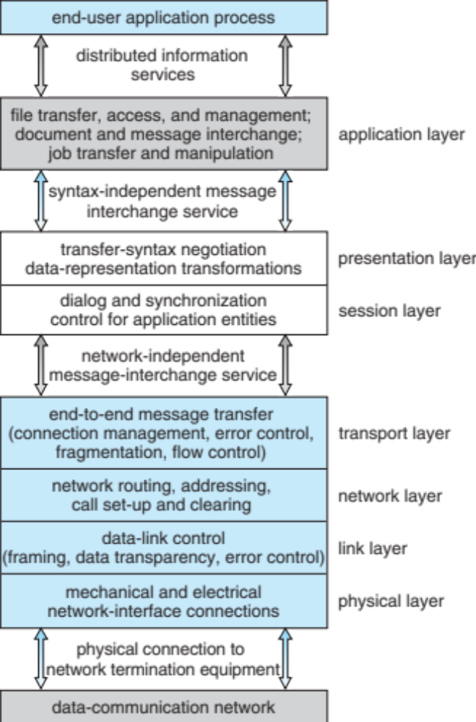
The ISO Protocol Layer

Slide 13
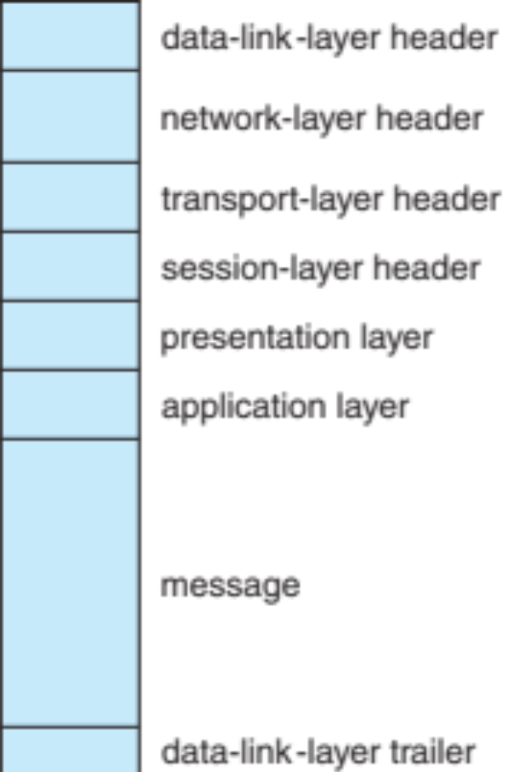
The ISO Network Message

Slide 14
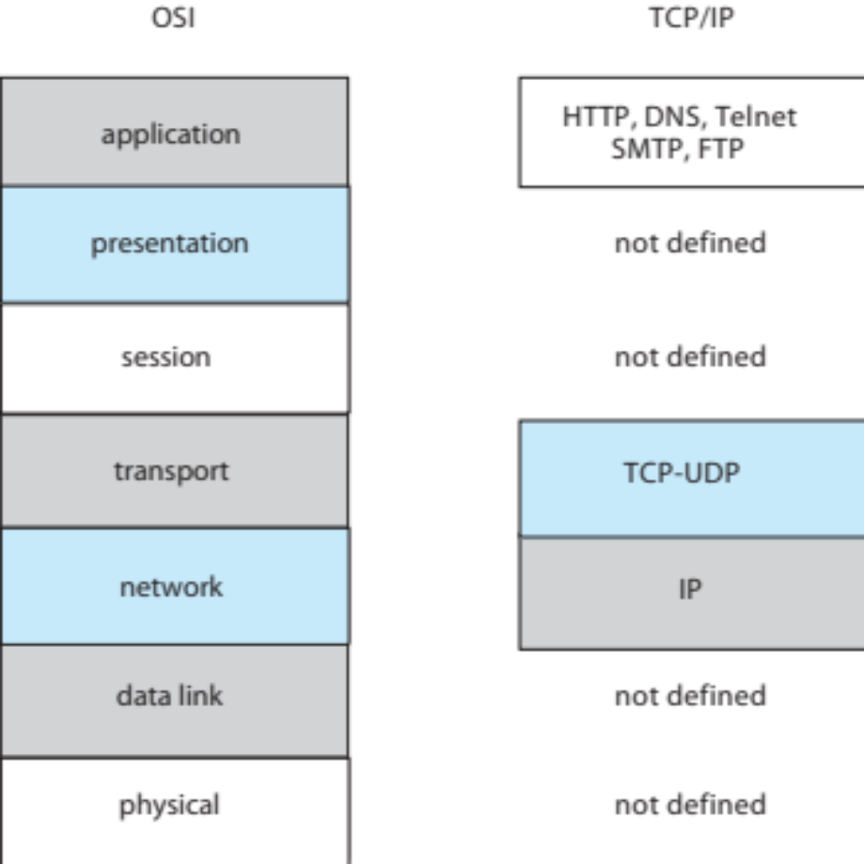
The TCP/IP Protocol Layers

Slide 15
Example: TCP/IP
The transmission of a network packet between hosts on an Ethernet network
Every host has a unique IP address and a corresponding Ethernet Media Access Control (MAC) address
Communication requires both addresses
Domain Name Service (DNS) can be used to acquire IP addresses
Address Resolution Protocol (ARP) is used to map MAC addresses to IP addresses
  Broadcast to all other systems on the Ethernet network
If the hosts are on the same network, ARP can be used
  If the hosts are on different networks, the sending host will send the packet to a router which routes the packet to the destination network

Slide 16
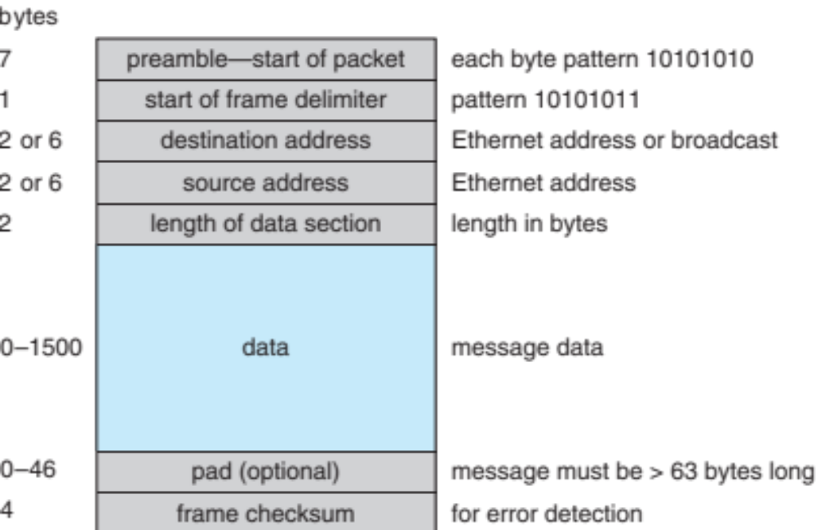
An Ethernet Packet

